Slide 1
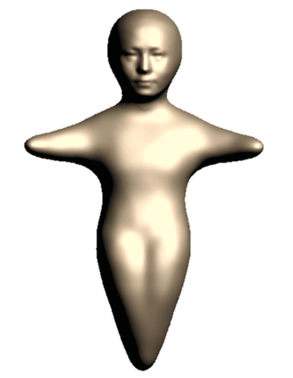
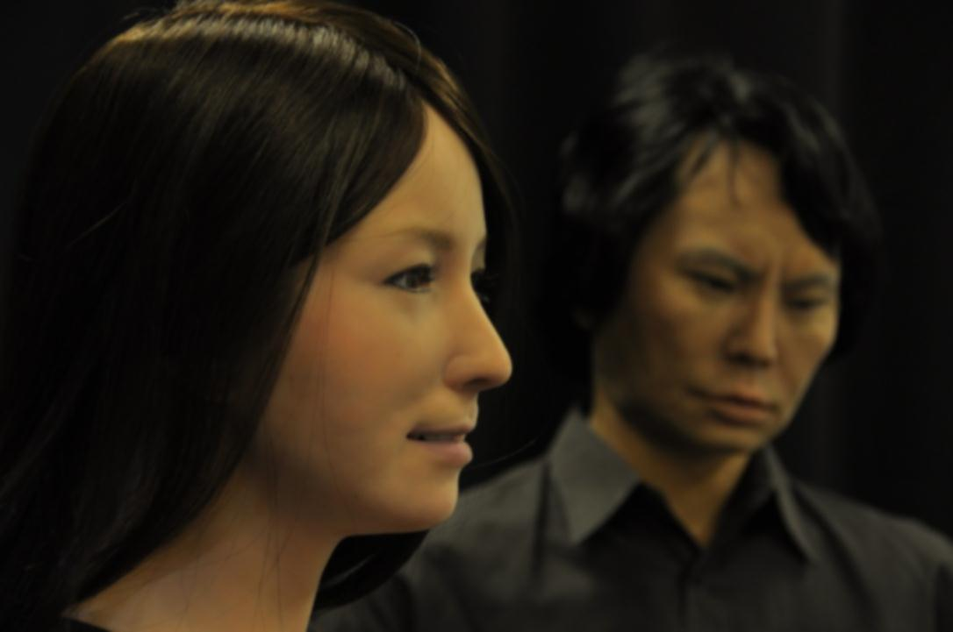
Studies on Interactive Humanoids
Hiroshi
ISHIGURO
Professor of Osaka University
Visiting Director of ATR Hiroshi Ishiguro Laboratories
Research Director of JST ERATO Ishiguro Symbiotic HRI Project
ishiguro@sys.es.osaka-u.ac.jp
www.is.sys.es.osaka-u.ac.jp, www.geminoid.jp．

Slide 2
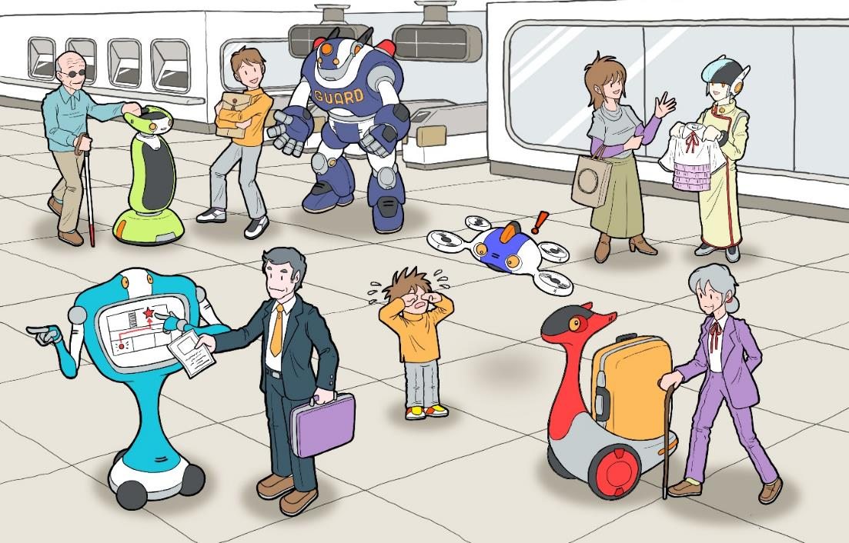
Human-Robot Symbiotic Society
Information/sensor network

Slide 3
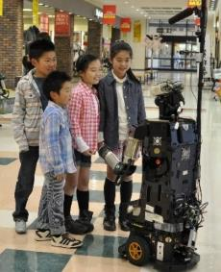

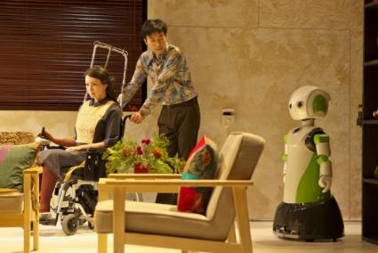
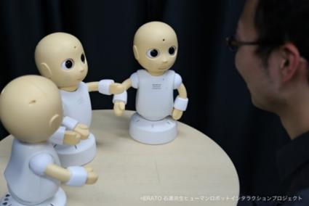
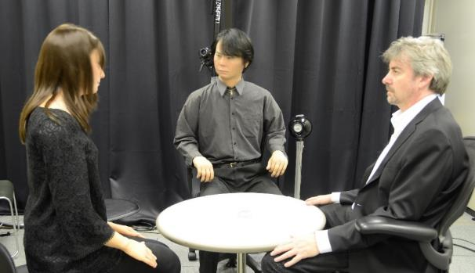
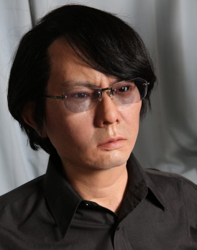
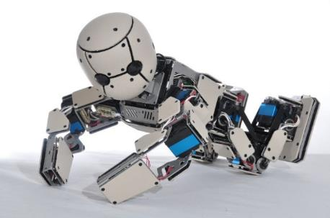
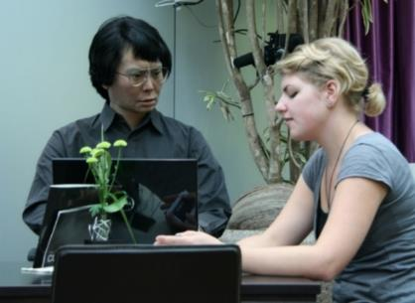
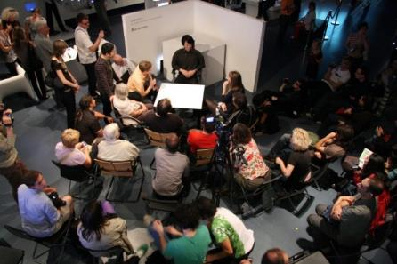
Humanoid robots
and
Android robots
Android
Human
Android

Slide 4
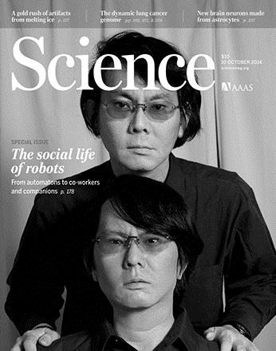
Why Do We Need Humanoid Robots?
Humans have a brain that recognizes humans.
The ideal interface for humans is a human.
Therefore, information media devices, e.g., talking rice cookers, should be at least partially humanlike.
Conversely, to understand humans, very humanlike robots (‘androids’) are needed.

Slide 5
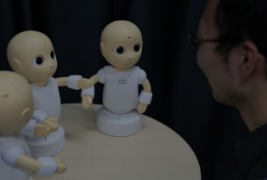
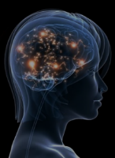
Constructive Science
with Intelligent Systems
Past brain studies have found that human intelligence comprises elements of memory, computation, inference, learning, etc. The challenge is to identify how these elements can be put together for realizing human intelligence.
The constructive approach will reconstruct robots and androids to model humans, and use such robots and androids to study human macro-level functions.
Intelligent
robotics
Developing humanlike robots
based on knowledge in science
Cognitive
& Neuro-
science
Understanding humans
by using the robots
Robot
Human
Android
Human
Technology
Science

Slide 6
Progress of Robot Technology and Human Science
“Cognitive Science with Robots”
Social relationship
Voice recognition
Consciousness
Image understanding
Intention/Desire
Sensor
Multi-modal Integration
Manipulator
Embodiment
Mechanics
Intelligence
Fundamental functions
of robots
Meta-level
Cognitive functions

Slide 7
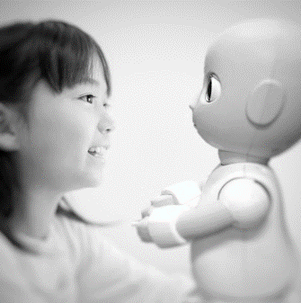
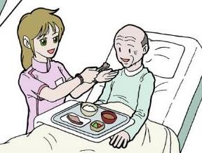
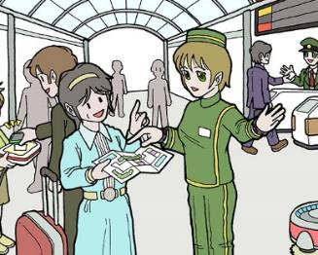
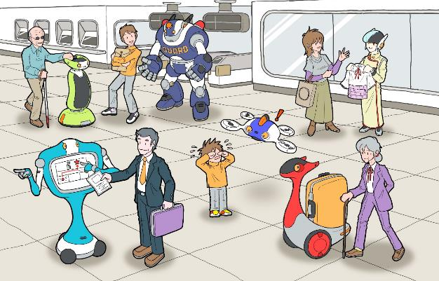
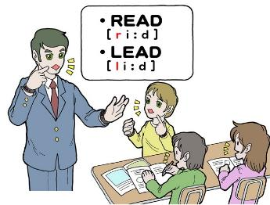
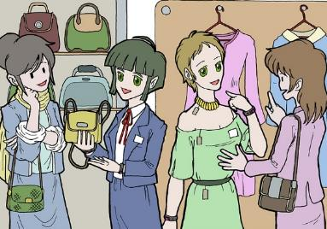
Robot Development
Companion robots
Counseling robots
Conversation training robots
Interpreter/Guide robots
Receptionist/Concierge robots
Shop keeper robots
Conversational robots for elderly and children
Language teacher robots
Oder-taking robots at restaurants
Intelligent sensor network
Self-organizing sensor network

Slide 8
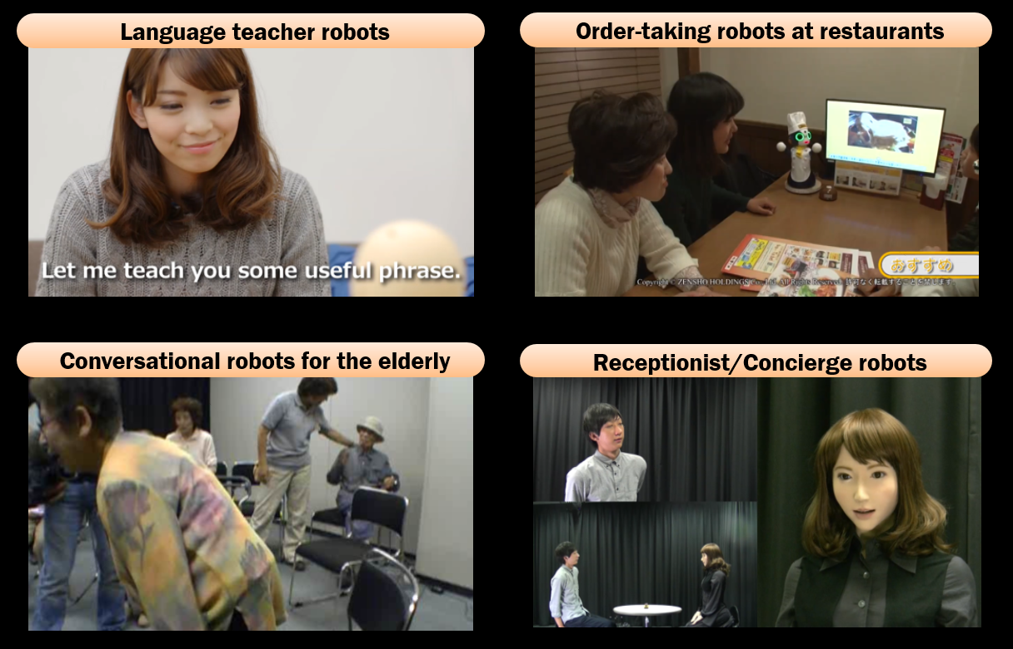

Slide 9

Science and Robot Development
Total Turing Test
Companion robots
Counseling robots
Consciousness
Social Relationship
Conversation training robots
Science
Intention/Desire
Embodiment
Interpreter/Guide robots
Intelligence
Multi-modal Integration
Receptionist/Concierge robots
Shop keeper robots
Conversational robots for the elderly and children
Language teacher robots
Robot development
Oder-taking robots at restaurants
2017
2022
2027

Slide 10
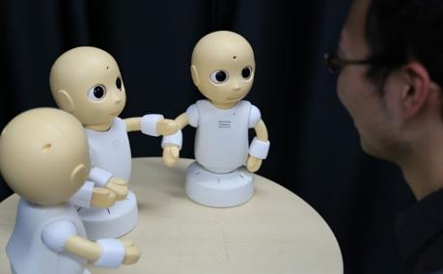


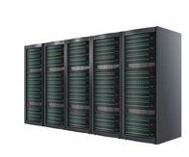
Total Turing Test (TTT) as a scientific and engineering goal
TTT is to compare between a robot manipulated by human operators
and an autonomous robot controlled by developed technology.
One of the important challenges in intelligent robotics is to pass TTT.
It evaluates the total humanlikeness through all of the modalities.
It evaluates the social acceptance as a member of our society.
Tele-operated Robot
Autonomous Robot
Compare
Interlocutor
Social Relationship
Interlocutor
Consciousness
Intention/Desire
Multi-modal Integration
Embodiment
Intelligence

Slide 11
Studies on Interactive Robots
Mechanical
Engineering
Engineering
Robotics
Systems
Engineering
Hypothesis
&
verification
Pattern
Recognition
Cognitive
science
Science
Neuro
science
Psychology

Slide 12
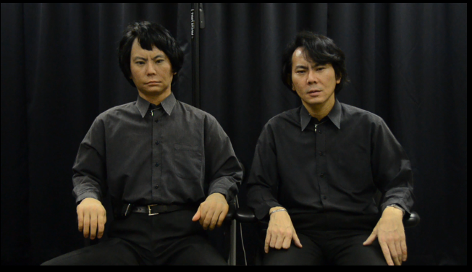
Studies on Interactive Humanoids
Social relationship
Consciousness
Intention/Desire
Multi-modal Integration
Embodiment
Intelligence

Slide 13
How Can We Develop the
Autonomous Conversational Robot?

Slide 14
Intention and Desire
We consider intention and desire causes emotion and consciousness of the robot.
The robot can be really humanlike with them.

Slide 15
Conceptual Architecture
C
Internal
Representa-
tion
C
C
Concept
C
Concept
(Desires)
Desire A
I
Intention
C
Access-level consciousness
Desire B
B
Behavior
R
Reaction
I
I
Internal
Representa-
tion
I
I
Intention
I
I
Real
World
B
B
Internal
Representa-
tion
for simulating
Physical world
B
B
Non self-other separation
B
B
Behavior
B
B
R
Reaction
R

Slide 16
Desire-Intention-Behavior Model
in the Meeting for the First Time
Behaviors
Dialogue with the selected topics
Intentional behaviors based on social rules
Find balance in the
Dialogue
Select topics according to the relationship with others
Control of
Initiative
Control of level of Self-disclosure
Speak or silence
Social Intention
Intention in dialogue
Personal Desire
Desire for relationship-building
Desire for clarifying
Relationships with others
Social Desire
Preference
Emotion
Recognition of social situations
Topics of interest
Likability to others
Recognition of relationships
Levels of self-disclosure

Slide 17
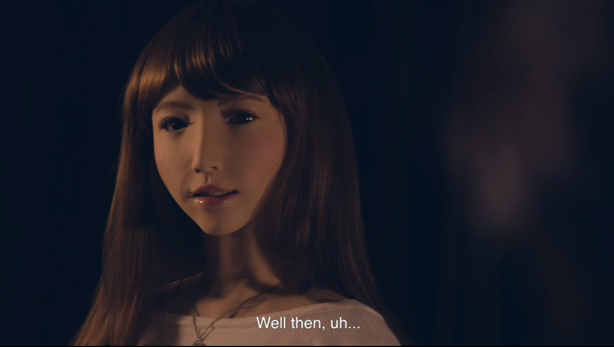
ERICA

Slide 18
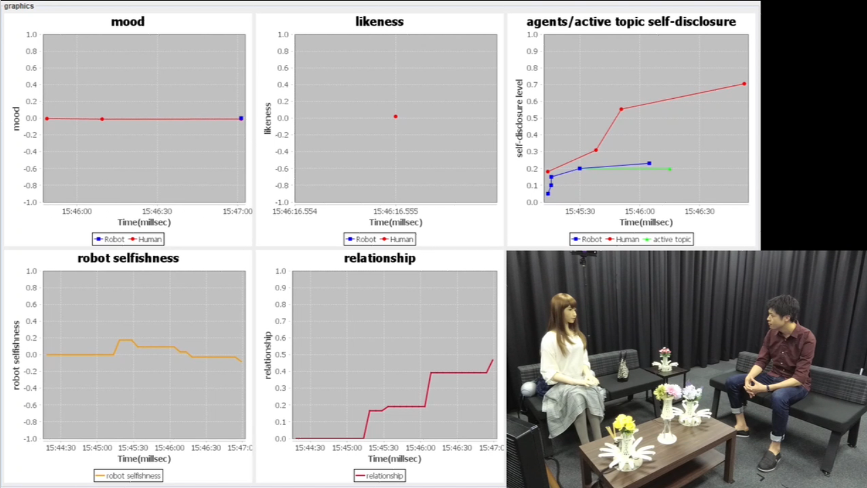

Slide 19
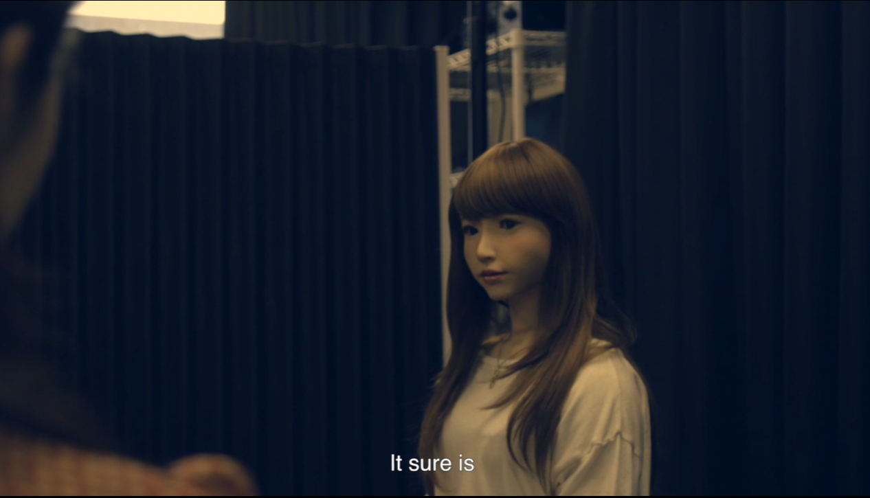
ERICA

Slide 20
The Future of Humanity
After several tens of thousand years

Slide 21
Human
Inorganic
intelligent life

Slide 22






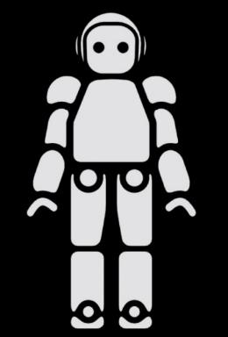
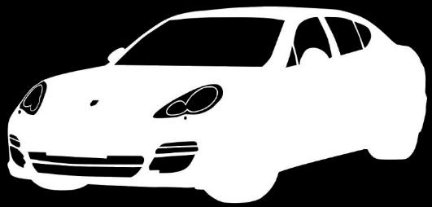
Diversity = Evolution

Slide 23
Two ways of human evolution

Slide 24
Gene
Technology

Slide 25
Technological Evolution Greatly Outpaces Genetic Evolution
Technology
Gene

Slide 26
Evolution by technology
Ability
5 M YBP Human being 10 K YBP Agriculture

Slide 27
Human＝Animal＋Technology
Technology
Animal

Slide 28
Technological Development Never Stops
Humans try to enhance their ability
based on the mission stored in their genes:
“To survive you must enhance your ability”

Slide 29
Technology that enhances human ability is highly attractive for humans, whose mission is to survive in this world.
Our goal is to obtain it and enrich our lives. (Economic development)
Therefore, technology rarely reverses direction
in human history.

Slide 30
To What Extent Do We Use Machines
in Our Daily Lives?
90% machine / 10% flesh & bones?

Slide 31
Evolution by Technology
Beyond the Limitations of Life
Replacing brain with computer

Slide 32
Human Evolution
Technology
Technology
(Inorganic material)
Animal

Slide 33
Ultimate Aim of Human Evolution
Immortality by
replacing flesh & bones
with inorganic material

Slide 34
Organic bodies are not a pre-condition
for human existence in today’s world
What is the definition of ‘human’?
Humans come from, and return to inorganic material

Slide 35
Inorganic
Organic
4.5 B YBP Birth of Planet Earth
3.5 B YBP Living creatures arrive
5 M YBP Human beings arrive
10 K YBP Agriculture starts
Present Humans & Machines
?K Year later Inorganic Humans
Inorganic

Slide 36
The Reason
That Organic Material Exists
Human’s organic body is a method
for accelerating the evolution
(to make it intelligent)

Slide 37
Organic
that has a complicated molecular structure
is highly adaptable to the environment
On the other hand,
the complicated structure
is very fragile

Slide 38
Inorganic
intelligent life

Slide 39
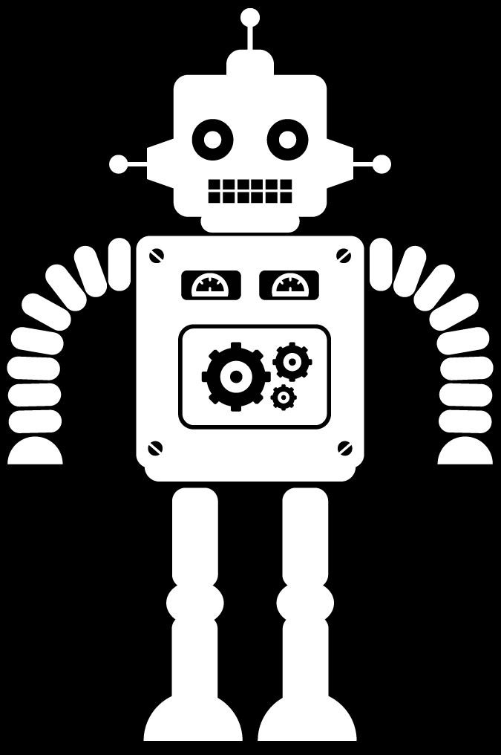

Slide 41
Diversity = Evolution

Slide 42
Diversity = Happiness
People can have different values.
People can have unique lives.

Slide 43
Human-Robot Symbiotic Society
Information/sensor network

